Slide 1

Unidad de Reumatología y
Laboratorio de Inmunología
Dr. Carlos A. Cañas, Dr. Fabio Bonilla-Abadía, Dr. Andrés Agualimpia,
Dr. Alex Echeverri, Dr. Andrés Hormaza, Bsc. Gloria Lucia Castaño,
Bsc. Carmen Manuela Castillo, Dr. David Aguirre, Dra. Erika Navarro,
Dr. Juan-Camilo Naranjo; Dr. Ivan Posso- Osorio; Dr. Gabriel J. Tobón

Slide 2
Objetivo…….
Investigación
Autoinmunidad
Cirugía bariátrica
Nefritis lúpica
Biomarcadores

Slide 3

9 posters
4 presentaciones orales
  Manifestaciones neurológicas del Síndrome de Sjögren
  Polimorfismos del gen DARC en la Artritis Reumatoidea
  Espectro de la enfermedad relacionada con IgG4 en Colombia
  Expresión de la citoquina BAFF y sus receptores en nefritis lúpica

Slide 4
BAFF and its receptors: How they are expressed in lupus nephritis?
Carlos Jiménez, MD; Juan Pablo Suso, MD; Fabio E. Ospina, MD; Aura Sánchez, BSc; Carlos A. Cañas, MD; Gabriel J. Tobón, MD, PhD

Slide 5
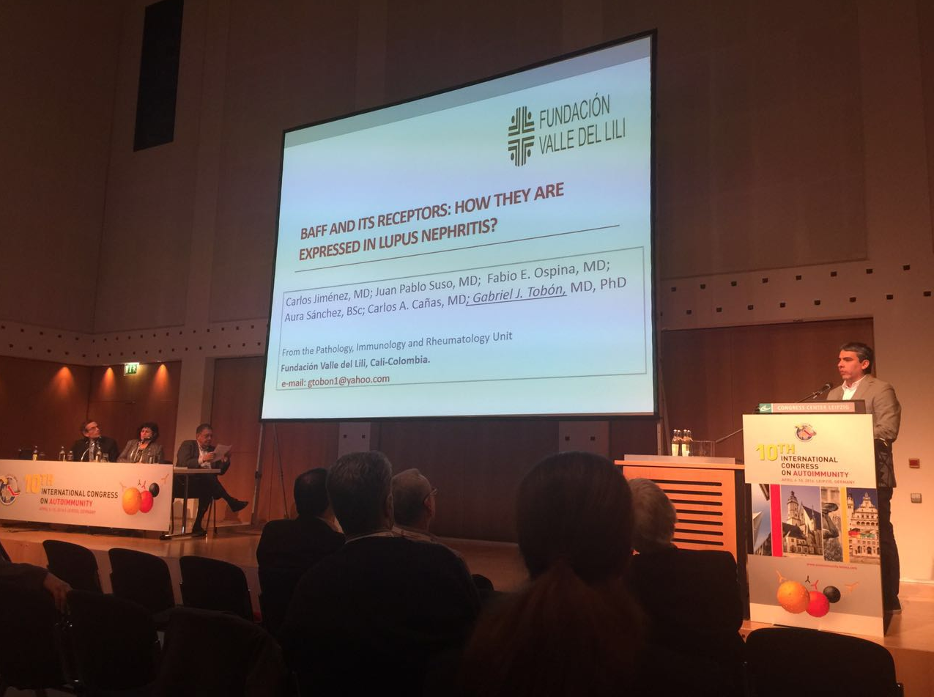

Slide 6
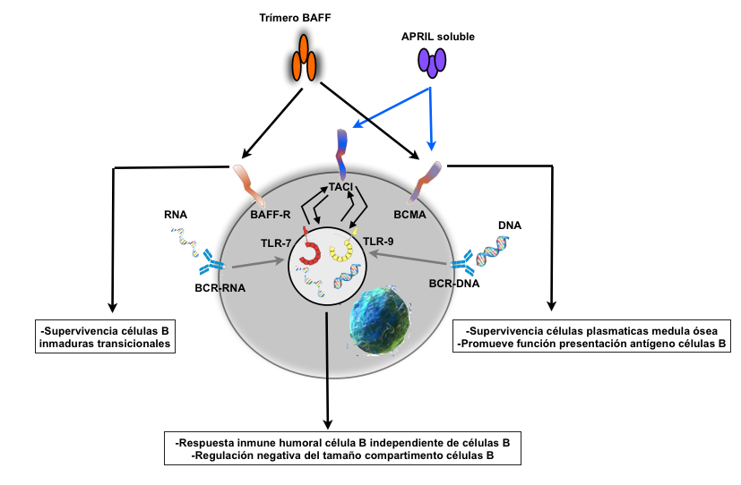
Introduction
BAFF
APRIL
Promotes survival and B-cell differentiation
Sustains GC
Selects transitional B cells into the mature B cell pool
Promotes lymphocyte maduration and antibody production
Promotes B cell proliferation
Strong stimulator of plasma cell survival
Stimulates IgM production

Slide 7
Introduction
BAFF contributes to murine and human autoimmune diseases, including Systemic Lupus and Sjogren’s syndrome
Interference with B-cell function by targeting this pathway is currently being investigated and used for systemic lupus erythematosus

Slide 9
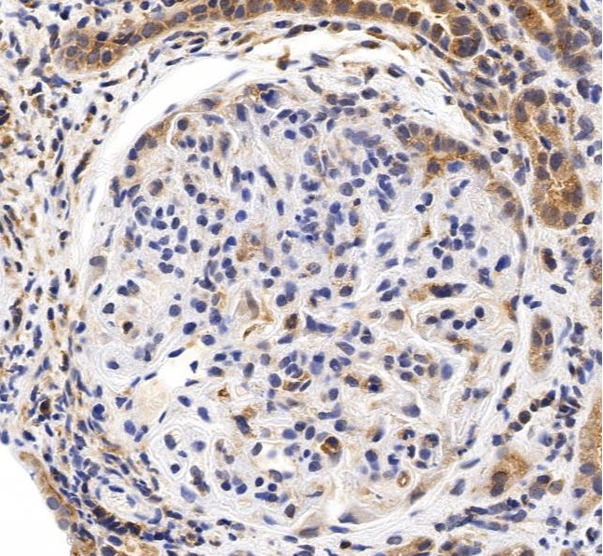
Introduction
However, the local expression of BAFF and their receptors in lupus nephritis has not been well studied.
Lupus Science & Medicine 2015;2: e000112

Slide 10
Objective
To evaluate BAFF and their receptors
(BAFF-R, BCMA and TACI) expression in renal biopsies with lupus nephritis diagnosis and its association with pathological class and inflammation scores.

Slide 11
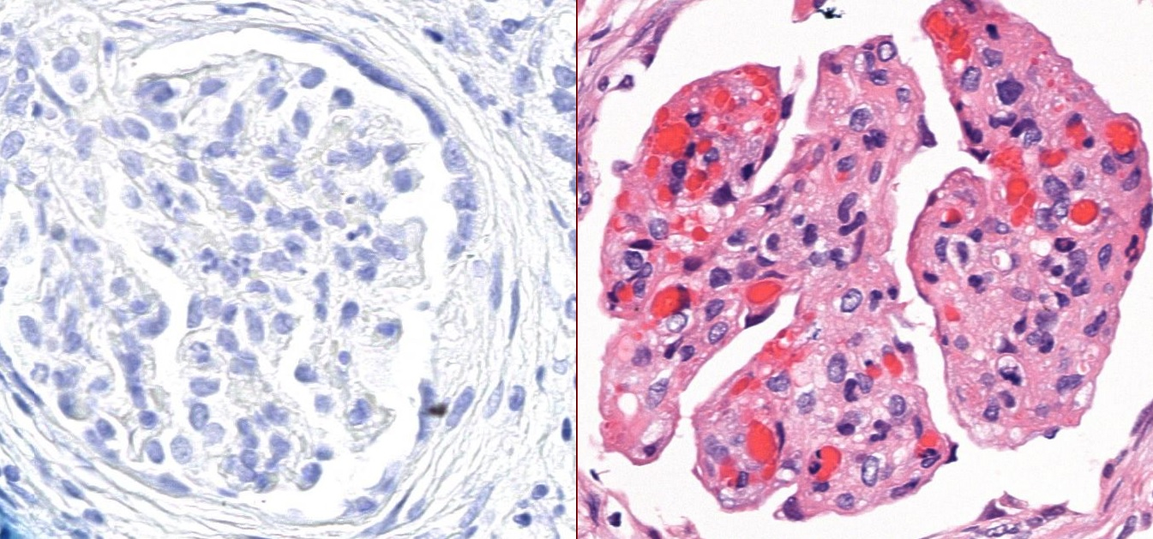
Methods
Renal biopsies from LN patients between 2011-2014 (n=45, mean age: 30.5 ± 13.9 years)
Classification of lupus nephritis (from class I to VI). ISN-RPS 2003
Activity scores from 0 to 24/Chronicity scores from 0 to 12. Austin et al. Am J Med 1983;75
Immunohistochemistry
  CD20 (L-20)
  BAFF (Buffy 2)
  BAFF-R (11C1)
  TACI (C-9)
  BCMA
Expression: 1: 0-25%; 2: 26-50%; 3: > 51%

Slide 12
Lupus Nephritis
International Society of Nephrology/Renal Pathology Society (ISN/RPS) 2003 classification of lupus nephritis
Class I Minimal mesangial lupus nephritis
Class II Mesangial proliferative lupus nephritis
Class III Focal lupus nephritis A: active lesions A/C: active and chronic lesions C: chronic lesions
Class IV Diffuse lupus nephritis
Class V Membranous lupus nephritis
Class VI Advanced sclerosis lupus nephritis
J Am Soc Nephrol 15: 241–250, 2004

Slide 13
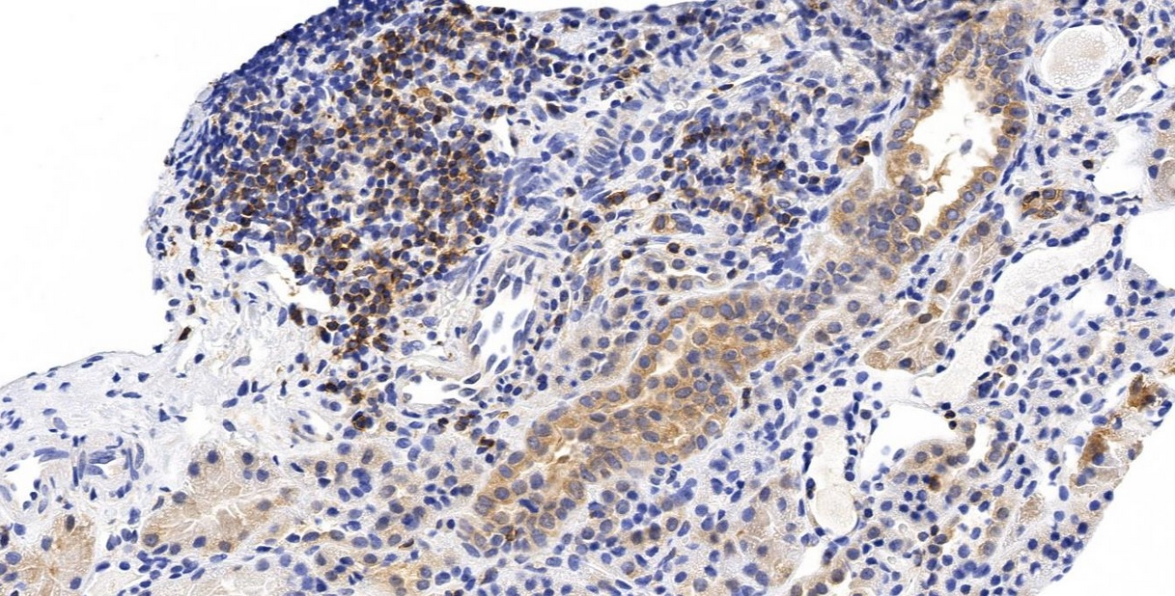
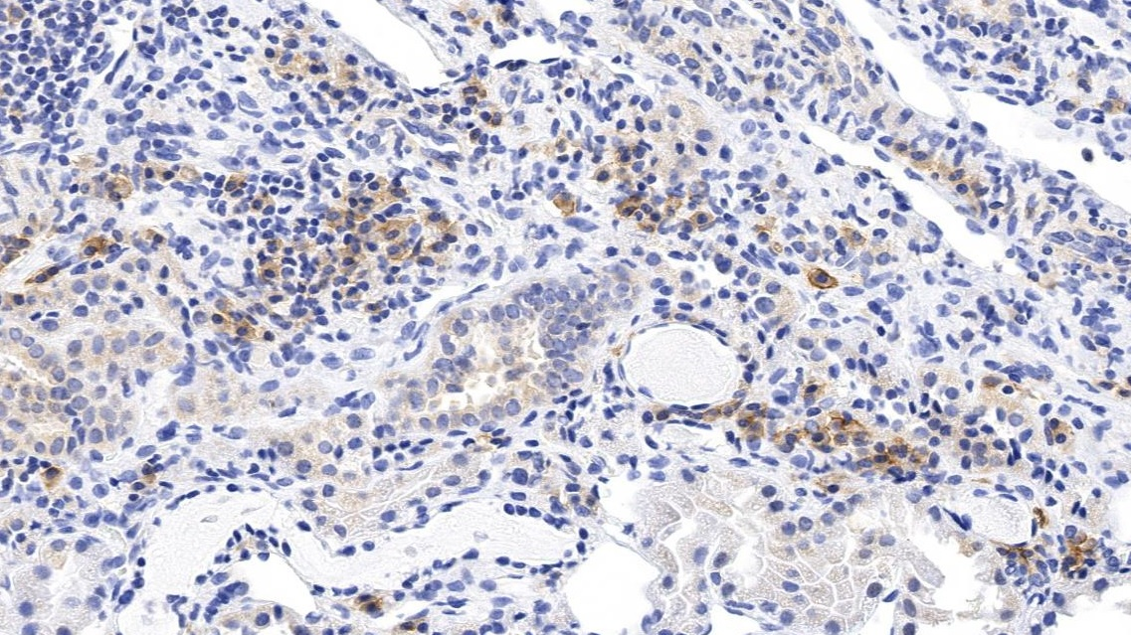
BAFF-R was not expressed on class II nephritis
n=5 | CD20 | BAFF | BAFF-R | TACI | BCMA
Interstitium | 1 | 2 | 0 | 1 | 1
Glomerular tuft | 0 | 0 | 0 | 2 | 0
BAFF
BCMA
Notes:
6387: BAFF INTERSTICIAL: EXPRESIÓN EN INFILTRADO INFLAMATORIO MONONUCLEAR.
6387: BCMA: EXPRESIÓN INTERSTICIAL EN INFILTRADO INFLAMATORIO
6387: CD20: EN EL INFILTRADO MONONUCLEAR INFLAMATORIO

Slide 14
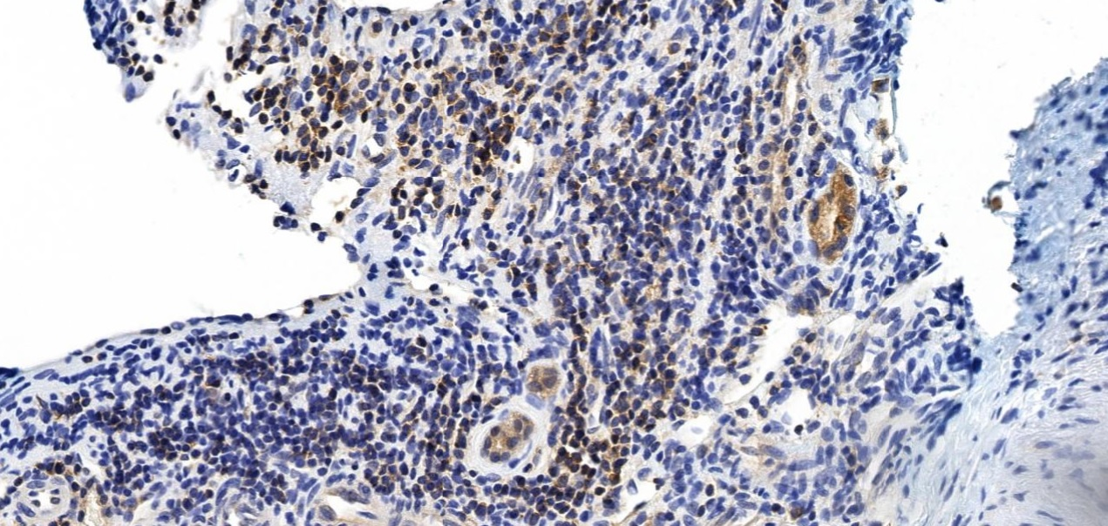
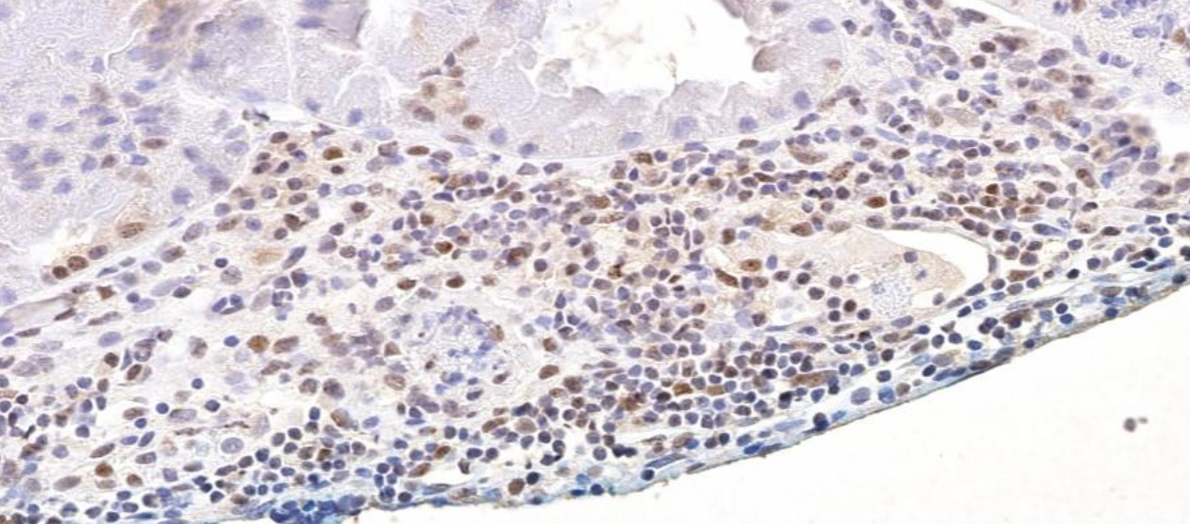
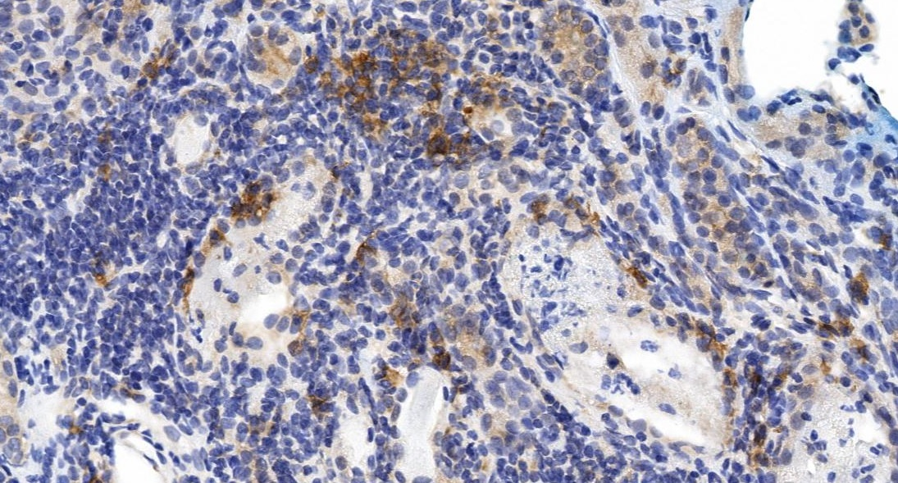
BAFF is expressed on the glomerular tuft in class III nephritis
n=11 | CD20 | BAFF | BAFF-R | TACI | BCMA
Interstitium | 1 | 1 | 0* | 1 | 1
Glomerular tuft | 0 | 2 | 0 | 1 | 1
* One patient with class IIIC had high expression (>51%)
TACI
TACI
BAFF
BCMA
Notes:
3621 BAFF: EXPRESIÓN EN MEMBRANA Y CITOPLASMA EN INFILTRADO INTERSTICIAL DE BAFF, CLASE IIIC, TÚBULOS ATRÓFICOS.
EN CLASIFICACIÓN IIIA VS. C DEPENDEN DE LA LESIONES GLOMERULARES
3621 BCMA : CITOPLASMÁTICO, EXPRESIÓN EN INFILTRADO INFLAMATORIO MONONUCLEAR INTERSTICIAL.
3621 INTERSTICIO: CD20 EN INFILTRADO INFLAMATORIO INTERSTICIAL
3621 TACI INTERSTICIAL: MARCACIÓN NUCLEAR EN EL TÚBULO EN TODOS LOS CASOS, Y EXPRESIÓN NUCLEAR DE CÉLULUAS INFLAMATORIAS
3621: TACI: MARCADORES EN PODOCITOS Y EN ALGUNAS CÉLULAS MESANGIALES NUCLEAR: GLOMÉRULO. EN IIIC.

Slide 15
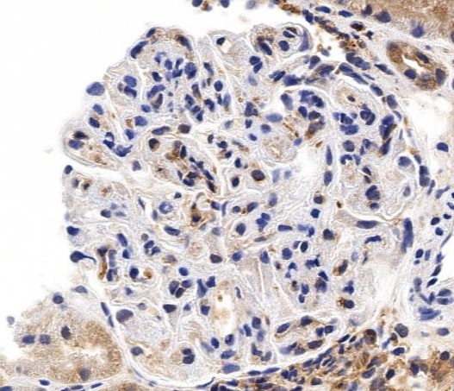
BAFF expression on the glomerulli is associated to inflammatory scores in class IV
n=24 | CD20 | BAFF | BAFF-R | TACI | BCMA
Interstitium | 1 | 2 | 1 | 1 | 1
Glomerular tuft | 0 | 3 | 0 | 2 | 2
BAFF
BAFF
Notes:
6387: BAFF INTERSTICIAL: EXPRESIÓN EN INFILTRADO INFLAMATORIO MONONUCLEAR.
6387: BCMA: EXPRESIÓN INTERSTICIAL EN INFILTRADO INFLAMATORIO
6387: CD20: EN EL INFILTRADO MONONUCLEAR INFLAMATORIO

Slide 16
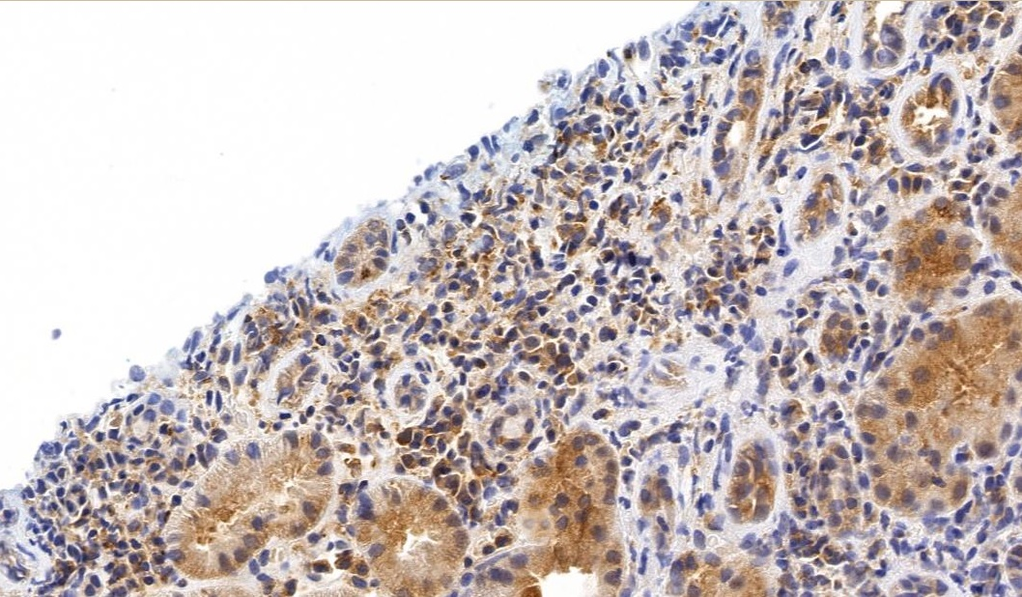
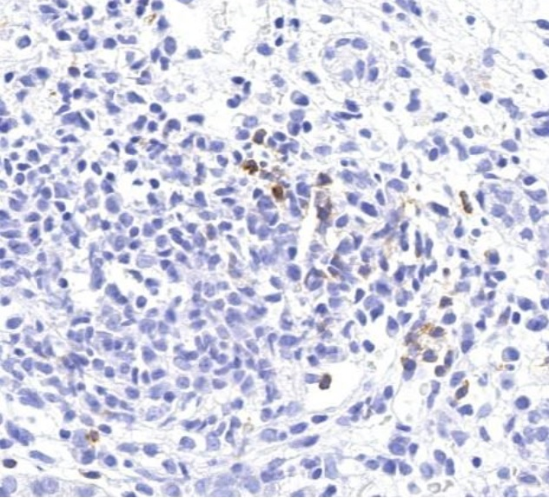
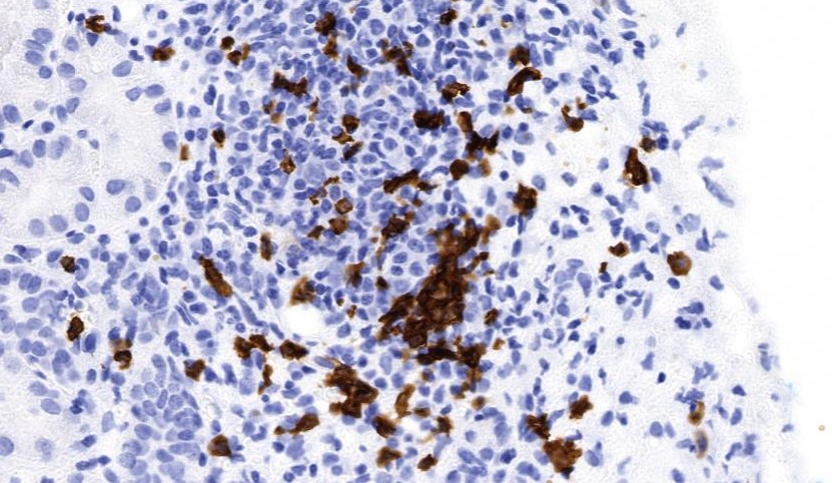
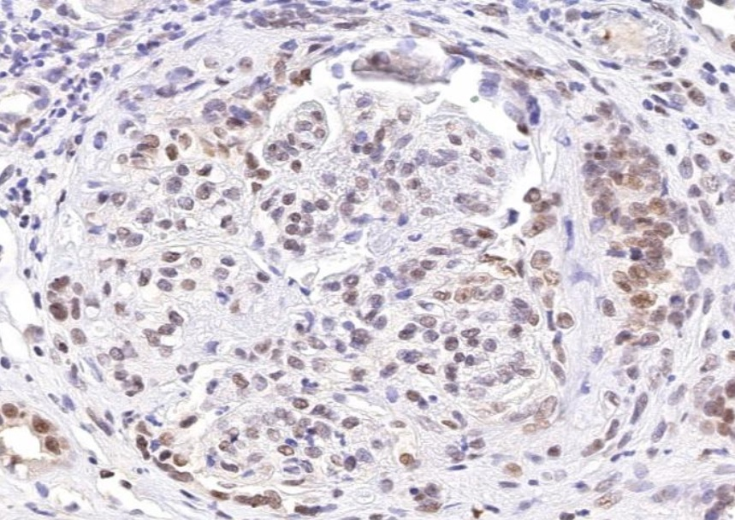
BAFF is also expressed in the interstitium infiltrates
BAFF
BAFF-R
CD20
TACI
Notes:
6387: BAFF INTERSTICIAL: EXPRESIÓN EN INFILTRADO INFLAMATORIO MONONUCLEAR.
6387: BCMA: EXPRESIÓN INTERSTICIAL EN INFILTRADO INFLAMATORIO
6387: CD20: EN EL INFILTRADO MONONUCLEAR INFLAMATORIO

Slide 17
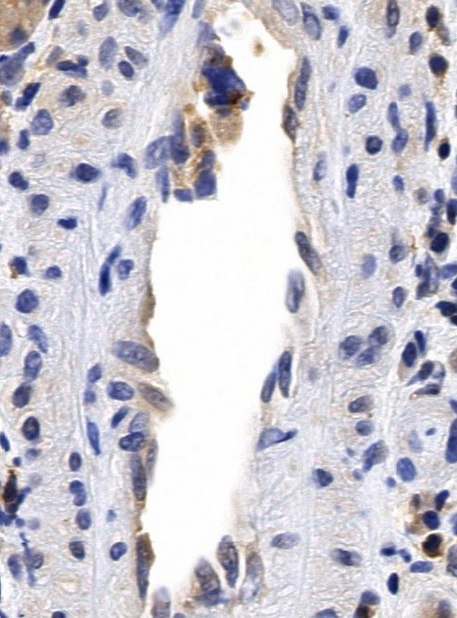
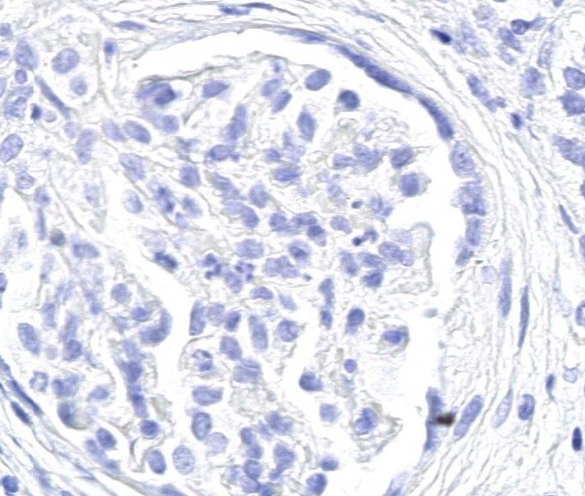
BAFF is expressed by endothelial cells in vasculopathy and not in thrombotic microangiopathy
BAFF
BAFF
Lupus vasculopathy
Thrombotic microangiopathy
Notes:
6387: BAFF INTERSTICIAL: EXPRESIÓN EN INFILTRADO INFLAMATORIO MONONUCLEAR.
6387: BCMA: EXPRESIÓN INTERSTICIAL EN INFILTRADO INFLAMATORIO
6387: CD20: EN EL INFILTRADO MONONUCLEAR INFLAMATORIO

Slide 18
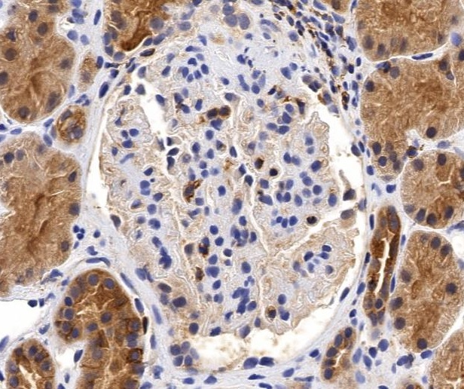
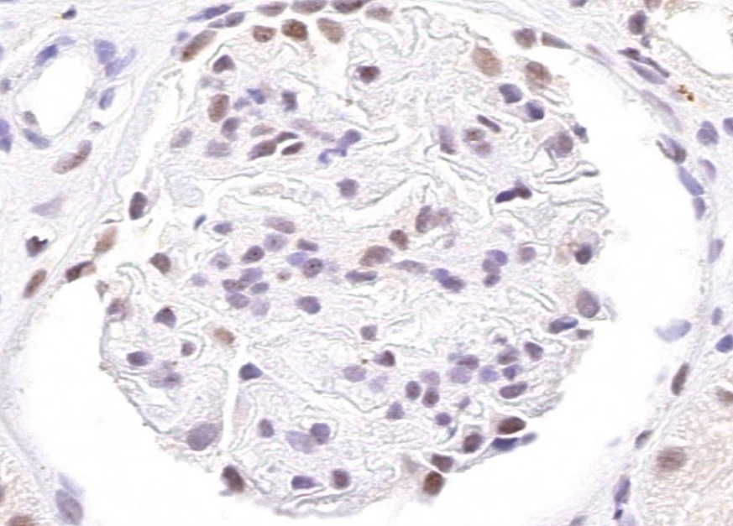
BAFF and TACI are expressed on glomerular tuft on class V lupus nephritis
n=5 | CD20 | BAFF | BAFF-R | TACI | BCMA
Interstitium | 1 | 1 | 0 | 0 | 1
Glomerular tuft | 0 | 2 | 0 | 2 | 2
BAFF
TACI
Notes:
CLASE V: PODOCITOS MUY ACTIVADOS EN SEMILUNAS Y TIPO V.
15384: EPXRESIÓN DE TACI EN POOCITOS ACTIVADOS (PERIFERIA) Y EN ALGUNAS CÉLULAS MESANGIALES.
15384.: BAFF: PODOCITOS Y EN AGLUNAS CÉLULAS MESANGIALES.
MAYOR CORRELACIÓN DE BAFF Y TACI EN TIPO V GLOMERULAR.
16105: BCMA: EN POCITOS Y CÉLULAS MESANGIALES.
15384: CD20: INFILTRADO INTERSTICIAL INFLAMATORIO.
Siempre TACI TUBULAR EN DIFERENTES DILUCIONES.

Slide 19
Conclusions
Diifferent expression patterns of BAFF and its receptors are found according to LN class.
The different expression of BAFF may be implicated in the physiopathology of LN class and complications (i.e. vasculopathy)
Further studies are needed to determine the importance of BAFF as a routine marker in LN biopsies, and to suggest which LN patients may benefit of anti-BAFF therapy.

Slide 20
Perspectivas
The expression of BAFF and its receptors in Lupus Nephritis may differentiate pathological nephritis class
Carlos Jiménez, MD¹; Juan Pablo Suso, MD^{2, 3}; Ivan Posso-Osorio, MD^{2, 3}; Fabio E. Ospina, MD ³; Aura Sánchez, BSc¹; Carlos A. Cañas, MD^{1,} Gabriel J. Tobón, MD, PhD^{2,4}*
Presentación oral en CORA 2017 Boloña-Italia

Slide 21
Perspectivas
Evaluación de la Expresión génica de la citoquina BAFF y sus receptores en el sedimento urinario de pacientes con sospecha nefritis lúpica, y su relación con las características histológicas, clínicas y de seguimiento.
Proyecto en curso: 10 pacientes

Slide 22
Objetivo…….
Investigación
Autoinmunidad
Cirugía bariátrica
Nefritis lúpica
Biomarcadores

Slide 24
¿Es la cirugía bariátrica un disparador de autoinmunidad?

Slide 25
Cambios inmunológicos asociados a la cirugía bariátrica: ¿Un nuevo disparador de autoinmunidad?
Gabriel J. Tobón, MD, PhD^{1, 2}*; Fabio E. Ospina, MD^{1, 3} ; Juan Pablo Suso, MD^{1, 3}; Ivan Posso-Osorio, MD; Andrés F. Echeverri, MD¹; Evelyn Muñoz-Buitrón, MD³; Gloria-Lucia Castaño BSc ², ; Javier-Darío Martínez, BSc²; Eliana Manzi, BSc ³ Andrés Agualimpia, MD¹, Fabio Bonilla-Abadía, MD¹, Evelyn Dorado, MD⁴ ; Carlos A. Cañas, MD¹

Slide 26
Introduction
Obesity is a proinflammatory condition.
We have described the development of systemic autoimmune diseases after bariatric procedures (Cañas et al, J Clin Rheumatol 2016)
However, immunologic variations associated to weight loss after bariatric procedures are unknown.

Slide 27
Objective
Our aim is to describe immunologic profile changes in obese patients following bariatric surgery.

Slide 28
Methods
Blood samples
Bariatric surgery time
Obese patients without AID
Baseline 4 months 8 months
Each sample was evaluated to determine:
Complement C3 and C4 levels
Antinuclear antibodies (ANAs)
IgG/IgM anti-Cardiolipin antibodies (aCL)
Anti-CCP antiboides
Rheumatoid Factor
Peripheral blood distribution of B and T lymphocytes
Leptine
Adiponectine

Slide 29
Results
Thirty-four patients were included (88% women).
Mean age at inclusion: 38.3 years.
Several immunologic changes were seen at 8 months:
Four patients (11.8%) with negative baseline ANAs had positive results
One patient with baseline ANAs 1:80 presented higher titles (1:160)
Anti-CCP was slightly positive in one patient (22 IU/mL, cutoff: 20) at baseline and the titers increased by 10 times at 8 months.
Complement C3 and C4 decreased in all patients compared to their baseline
IgM aCL and RF did not change during follow-up.
No important changes were evidenced at 4 months.

Slide 30
Results
Parameter | Baseline | 8 months | P
BMI* | 42.8 ± 3.6 | 33.5 ± 5.3 | 0.001
C3* | 164 ± 40.6 | 112.4 ± 31.4 | <0.001
C4* | 29.3 ± 10.1 | 22.5 ± 7.1 | 0.0009
IgG aCL (GPL) * | 7 | 3 | <0.001
Leptine * | 45.7 ± 9.14 | 23.5 ± 12.6 | <0.001
Adiponectine* | 6.6 (5 - 10) | 10 (6 - 17) | 0.0001
* mean ± SD * Paired t test
** median, IQR ** Wilcoxon signed-rank test

Slide 31
Results
Parameter | Baseline | 8 months | P
T CD4, %* | 44.6 ± 8.3 | 45.8 ± 7.4 | 0.0179
T CD8, %** | 21 (18-24.9) | 20.1 (16.9-23.2) | 0.0002
CD4 number** | 1074 (860-1316) | 1217.5 (838-1510) | 0.0016
CD8 number** | 494 (355-634) | 502.5 (378-632) | 0.3876
CD4/CD8 ratio** | 2.2 (1.7-2.7) | 2.4 (1.8-2.8) | 0.0001
* mean ± SD * Paired t test
** median, IQR ** Wilcoxon signed-rank test

Slide 32
Conclusions
Our results showed immunological changes after bariatric surgery (mainly in C3 and C4 levels, positivity of ANAs and variation in T cells distribution).
Clinical implications of these findings must be analyzed in the follow-up of our cohort.

Slide 33
Perspectivas
Prolongación del seguimiento: 4ta toma
Escritura artículo

Slide 34
Objetivo…….
Investigación
Autoinmunidad
Cirugía bariátrica
Nefritis lúpica
Biomarcadores

Slide 35
Rheumatology (Oxford). 2016 Oct 15. pii: kew340

Slide 37
Biomarcadores para diferenciar actividad lúpica vs. Infección en pacientes con LES y SIRS
Alex Echeverri¹; Juan-Pablo Suso^{1,2}; Javier-Dario Martínez³; Ivan Posso-Osorio^{1,2}, David Aguirre¹; Fabio E. Ospina^{1,2}; Juan Camilo-Naranjo; Diana P. Zambrano, Gloria-Lucía Castaño³; Andres A. Hormaza¹; Carlos A. Cañas¹; Gabriel J. Tobón^{1,3}

Slide 38
Introduction
Differentiation of Systemic Lupus Erythematosus (SLE) activity and infection in a febrile patient become difficult, since initial clinical presentation may be similar.
Several biological markers (including procalcitonin and CRP) have been evaluated, with discordant results.

Slide 39
Objective
The aim of this study is to evaluate the utility of biomarkers to differentiate infection vs. activity in SLE patients admitted with systemic inflammatory response (SIRS).

Slide 40
Methods
Twenty-three patients with SLE (ACR criteria 1997) and SIRS (International conference 2001) admitted to the ER and ICU.
Procalcitonin, CRP, ESR, anti-DNA titers, C3, C4, SLEDAI and neutrophil CD64 expression.
Infection was considered if a positive culture/PCR was obtained.
Mann-Whitney test was used to evaluate the association of variables with infection.

Slide 41
Results
Twenty patients were female (86%), mean age 32.7 years.
An infectious disease was confirmed in 10 patients (8 bacterial including urinary tract infection, and pneumonia; 1 viral infection by Chikungunya virus and 1 fungal).
All the markers for SLE activity, including anti-DNA titers (p=0.08), C3 (p=0.55), C4 (p=0.87) and SLEDAI (p=0.06) were not different between patients with and without infection.
CRP was also not able to differentiate these two conditions (p=0.68).

Slide 42
Results
On the contrary, procalcitonin levels (p=0.005) and neutrophil CD64 expression by flow cytometry (p=0.05) were high in infected SLE patients.

Slide 43
Betancur JF, Navarro EP, Echeverry A, Suso JP, Bravo Bonilla JH, Daniel Cortés A, Cañas Dávila C, Vélez JD, Tobón GJ.Arthritis Rheumatol. 2016;68:1044.

Slide 44
Conclusions
High neutrophil CD64 expression and procalcitonin levels are useful to differentiate infections from activity in SLE patients. If both markers are positive, an infectious disease was demonstrated in all cases.

Slide 45
Perspectivas
Realización de presepsina (CD14 soluble) para evaluación como biomarcador.
Presentación posters CORA 2017 Boloña-Italia

Slide 46
Objetivo…….
Investigación
Autoinmunidad
Cirugía bariátrica
Nefritis lúpica
Biomarcadores

Slide 47
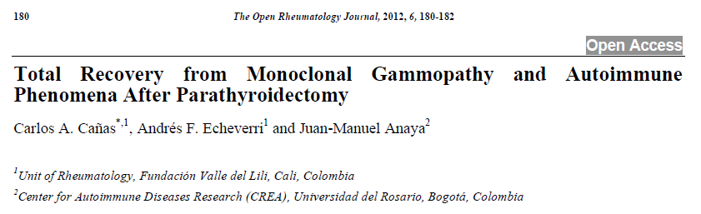
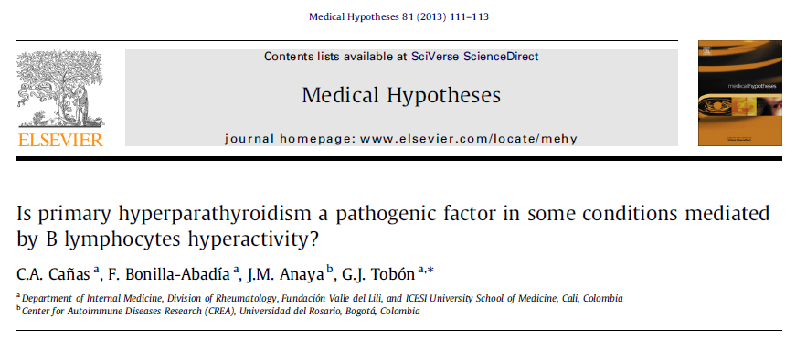
Autoinmunidad: nuevas hipótesis

Slide 48
Autoinmunidad: nuevas hipótesis
Efectos de la hormona paratiroidea en los linfocitos B de personas sanas y pacientes con enfermedades autoinmunes:
Ivan Posso-Osorio, Carmen Castillo, Gloria Lucía Castaño, Juan-Camilo Naranjo.
Anticuerpos anti-DFS70 (Dense-Fine Speckled) como marcador de exclusión de lupus eritematoso sistémico en personas con ANAs positivos:
Juan David González, Cristian Camilo Aragón, Germán Puerta Sarmiento, Iván Posso Osorio, Juan Camilo Naranjo, Gloria Castaño, Carmen Castillo.
Caracterización de los pacientes con linfopenia CD4 idiopática: Lisa Rodriguez.
Biobanco de pacientes con LES.

Slide 49
Enfermedades autoinflamatorias
An adult patient with a novel mutation in NLRP3 gene associated with Cryopyrin-Associated Periodic Syndrome
Vanessa Ocampo, MD ¹; Ivan Posso-Osorio, MD²; María-Clara Ortiz-Sierra, MD³; Andrés F. Echeverri, MD⁴; Juan-Pablo Suso, MD²; Gabriel J. Tobón, MD, PhD^{2,5}
Exome sequencing found a novel missense mutation in exon 5 of the NLRP3 gene E607V (c.1820A>T) (NM_001079821.2), predicting a deleterous efect on different programs (PROVEAN, SIFT, PolyPhe2, MutationTaster, MutationAssesor and FATHMM).

Slide 50
Colaboraciones
Biomarcadores en Orina de Pacientes con Lupus Eritematoso Sistémico - Cohorte GLADEL 2.
Señalización Cálcica en los linfocitos B de pacientes con LES, Brest-Francia

Slide 51
Artículos Publicados
14 artículos internacionales
3 artículos nacionales
3 capítulos de libro
1 libro
10 artículos sometidos a revistas nacionales e internacionales
Trasplante renal en pacientes con LES: Lupus (Juan-Camilo Naranjo, Eliana Manzi)
3 trabajos aceptados en CORA 2017

Slide 52
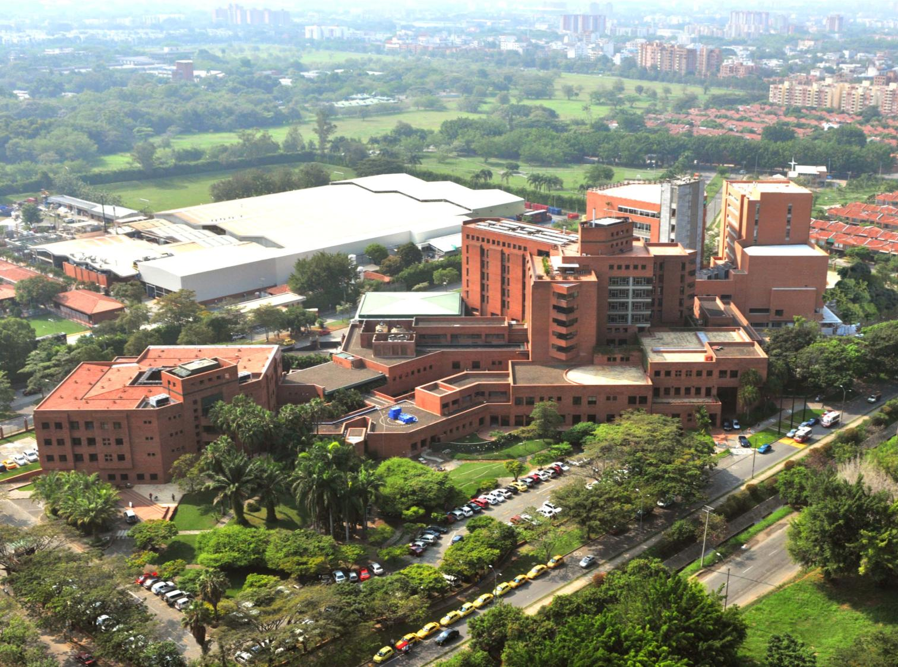
Muchas gracias…

